Slide 1
Concept:
Basic Java:
Java Threads:
Design Pattern:
Java 8:
Hibernate
Spring
Karaf
HTML/HTML5
CSS/CSS3

Slide 2
Concept:
10. JavaScript
11. Jquery
12. AngularJS
Big Exercises: Music Manager System

Slide 3
Basic Java
Understand about:
Classes, Fields, Method.
Object, Object References
Primitive Data Types and Wrapper Data Type
Learning about:
Operators
Flow Controls, Collection

Slide 4
Basic Java
Basic OOP:
Class and instances
Characteristics: Inheritance, Polymorphism, Abstraction, Encapsulation
Access Modifiers
Association
Override & Overload
Abstract Class & Interface
Covariant Return Type

Slide 5
Java Threads
Life cycle of thread: new, runnable, waiting, timed waiting, terminated
Synchronizing Codes
Deadlock

Slide 6
Design Pattern
Adapter Pattern
Singleton Pattern
Factory Pattern
Abstract Factory Pattern
Observer Pattern
State Pattern
Strategy Pattern

Slide 7
Java 8
Lambda Expression
Method reference
Stream
forEach
String Joiner
Optional Class

Slide 8
Hibernate
Understand: ORM, Hibernate and why use Hibernate
Architecture of Hibernate
Association and Collection Mapping
Annotations and Mapping File Config
Hibernate Life Cycle
Transaction Management
HQL(Hibernate Query Language) and Native Language
Hibernate Caching

Slide 9
Spring
Understand Spring
Spring Architecture
Dependency Injection: IoC Container, Setter DI, Constructor DI,
Factory Method
Autowiring
Spring with Hibernate

Slide 10
Karaf
Understand OSGI, Karaf and Karaf’s Bundle
Karaf Architecture
Start/stop and deployed a bundle
Learning about: Karaf blueprint, Karaf bundle, Karaf jdbc, Karaf JPA, Karaf Maven, Karaf war, Karaf RESTFul

Slide 11
HTML/HTML5
HTML Syntax
HTML Tags
HTML File Path
HTML5 Layout: [header, nav, section, aside, footer, article] tag
HTML Responsive
HTML5 new tag: audio, sgv, video, canvas,...
Media: video, audio, plugins: embed and object tag, youtube embed.
Geolocation, Drap&Drop
Storage: Web Storage, Local Storage, Session Storage

Slide 12
CSS/CSS3
Understand CSS/CSS3
Syntax of CSS/CSS3
Understand to insert CSS/CSS3 in project
CSS3 Box Model
Learning some CSS attribute for text, link, list, font, table, form
CSS Selector
CSS3 animation
CSS3 box sizing
Learning about Bootstrap, Font AweSome

Slide 13
JavaScript
Understand JavaScript
Syntax of JavaScript
Variable
DOM events
Method about string, number, array
Query DOM( Finding HTML elements by [ id, class, name, tag name, css selector ])
JSON and XML
Callback
Object, Function and Scope

Slide 14
JavaScript
Timeout and Interval
Prototype

Slide 15
Jquery
Understand jquery
Selectors: All selector starts with $
Events: Mouse, Keyboard, Form, Document
jquery CSS: add, remove and toggleClass() and css()
AJAX: load(), get() and post() method
Effects

Slide 16
AngularJS
Understand AngularJS and its concepts
Directives: ng-app, ng-model, ng-controller, ng-init, ng-click,... and custom a directive
Databinding: use ng-bind directive or {{expression}}
MVVM Model
Scopes, Service, Module
Filter and custom a filter
Angular config
APIs of angularJS: ngRoute, ngAnimate,...

Slide 17
Big Exercise: Music Manager System
Overview:
Music Manager System allows you to browse through a music library. You can add new entries(Song) and delete them and CRUD
Music will be stored server side in database. The client will communicate with server via web client use RESTFul API.
On Server Side, we will develop by Karaf JPA and use Hibernate for database.
On Client Side, we will develop by AngularJS Application with Bootstrap 3.3.7, jquery, JSON

Slide 18
Big Exercise: Music Manager System
2. Server Side:
We will build server side based on the example of Karaf RESTFul:
Project API: includes Entity and interface Entity Service
Project service: include DAO and Service Implement API
Project RESTFul: define services based project API
Project Feature: define feature to use in karaf command
Four project are maven project and will be managed by a big simple Maven project

Slide 19
Big Exercise: Music Manager System
2.1. Project API:
We built a maven project use dependency persistence to define Entity.
Create a package, includes: Song Entity and SongService:
Song Entity (persistence entity): includes fields: id, name, genre, lyrics and getor, setor, constructor.
SongService is a interface have methods such as:
list(): show all list Song in database
get(int id): get a song by id
add(): add a new song
update(): update a song

Slide 20
Big Exercise: Music Manager System
2.1. Project API:
SongService is a interface have methods such as:
remove and removeAll method: delete a song by id and delete all song in list song.
getbyName(): select list song by query name
getCountListSong(): get sum of list song
getSongPagination(): get song to use for pagination

Slide 21
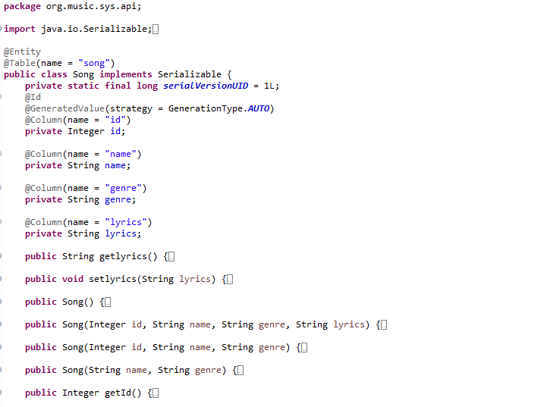
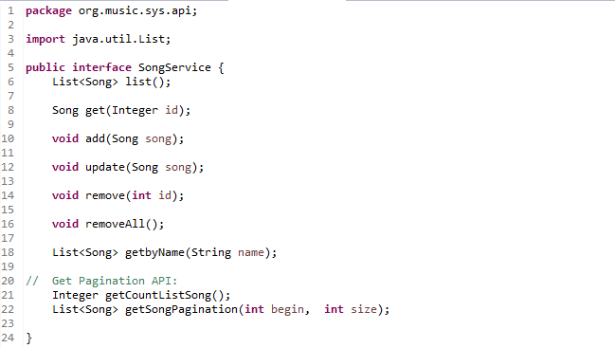
Big Exercise: Music Manager System
2.1. Project API:

Slide 22
Big Exercise: Music Manager System
2.2. Project service:
Project service use dependencies, such as: persistence, transaction.
In project, we will create 2 package:
DAO package, includes:
SongDAO interface(it same as interface SongService of Project API)
SongDAOImpl class: Implement interface SongDAO.
Service package, includes:
SongServiceImpl class: Implement interface SongService but use method of SongDAO.

Slide 23
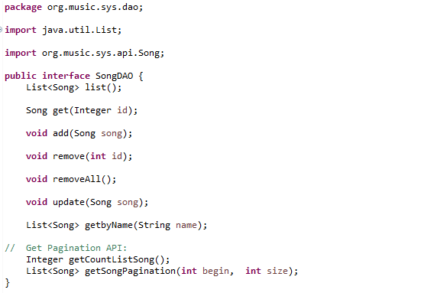
Big Exercise: Music Manager System
2.2. Project service:
SongDAO: have method same as SongService

Slide 24
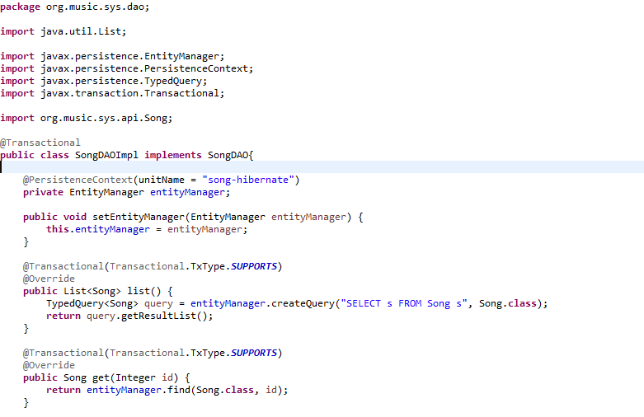
Big Exercise: Music Manager System
2.2. Project service:
SongDAOImpl class: Use Hibernate - JPA to communicate with database
Create Persistence to use for JPA Database and create a EntityManager to use query
Define list method by query use HQL to get list song in database
Define get method to find a song by id

Slide 25
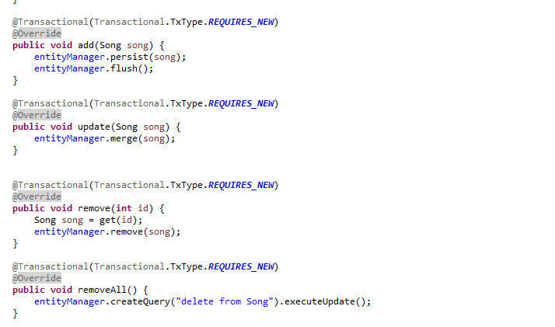
Big Exercise: Music Manager System
2.2. Project service:
SongDAOImpl class: Use Hibernate - JPA to communicate with database
Define method add, update, remove, removeAll by HQL
The TxType element of the annotation indicates whether a bean method is to be executed within a transaction context where the values provide the corresponding behavior, such as REQUIRES_NEW, SUPORT

Slide 26
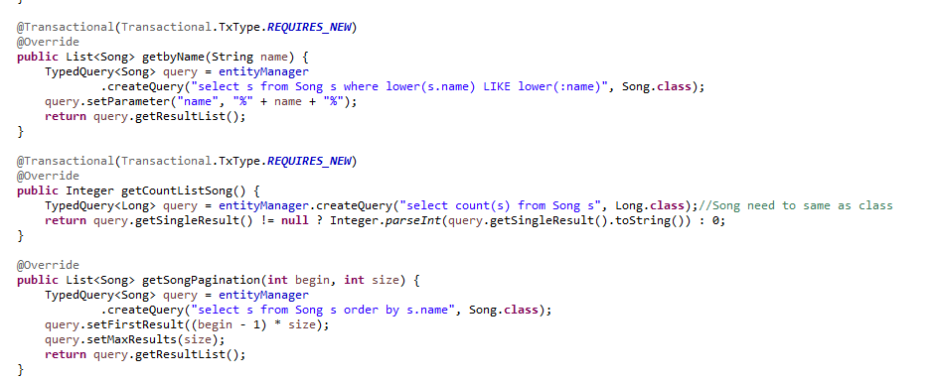
Big Exercise: Music Manager System
2.2. Project service:
SongDAOImpl class: Use Hibernate - JPA to communicate with database

Slide 27
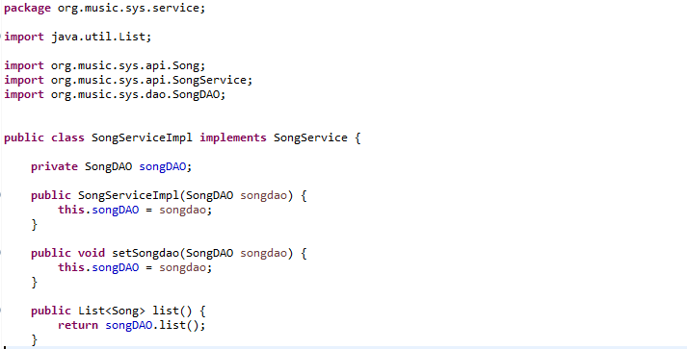
Big Exercise: Music Manager System
2.2. Project service:
SongServiceImpl: In package service, this class implement interface SongService of Project API and body method will use method of SongDAO, sample:
Declare SongDAO as field. And define it in constructor
list() method return list() method of songDAO

Slide 28
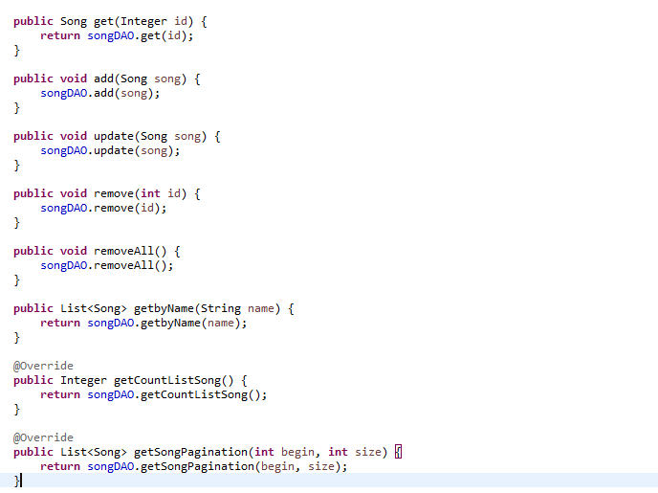
Big Exercise: Music Manager System
2.2. Project service:
SongServiceImpl:
Define method: add, get, update, remove, removeAll, getByName, getCountListSong, getSongPagination.

Slide 29
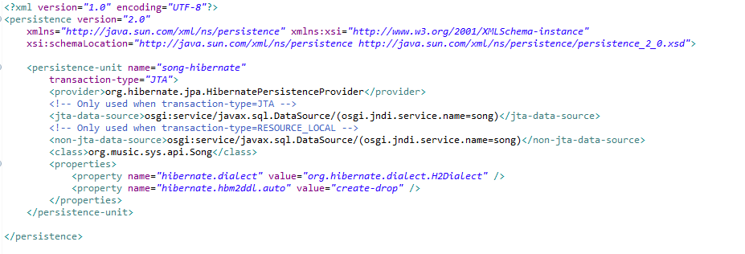
Big Exercise: Music Manager System
2.2. Project service:
To Service Project communicate with database, we define persistence in resource sure JPA to use. And we define bean to sure that classes are used to communicate with JPA.
Define transaction is JPA or not, use class Song is Table, and define use hibernate

Slide 30
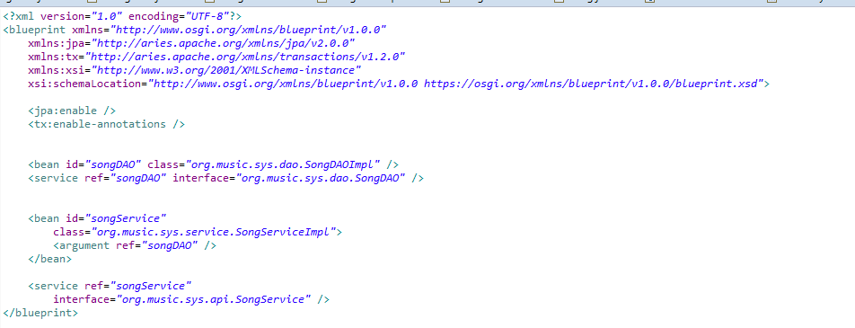
Big Exercise: Music Manager System
2.2. Project service:
To Service Project communicate with database, we define persistence in resource sure JPA to use. And we define bean to sure that classes are used to communicate with JPA.
Register class into bean

Slide 31
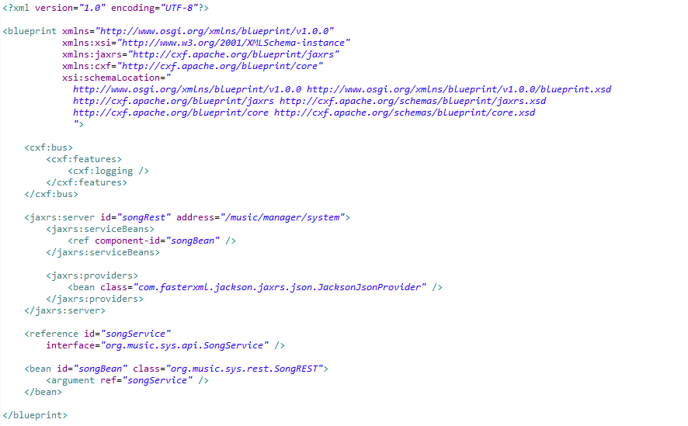
Big Exercise: Music Manager System
2.3. Project RESTFul:
To create a RESTFul project will need use javax.ws.rs.* Library.
First, we need to define RESTFul.xml to register address, service need to use and bean to use class.

Slide 32
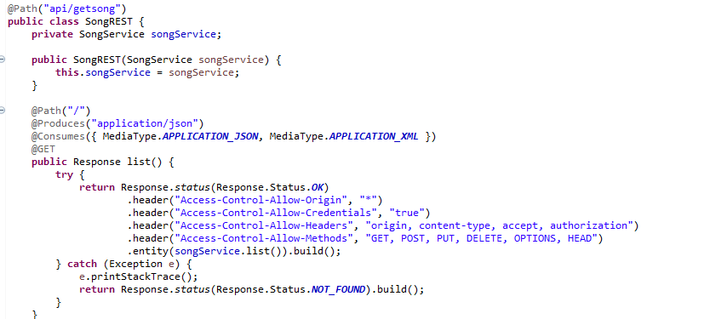
Big Exercise: Music Manager System
2.3. Project RESTFul:
Create a package and class in the package, we have:
Path address API addition
Create a Response function
Header Response
method list() of SongService to use to respone data

Slide 33
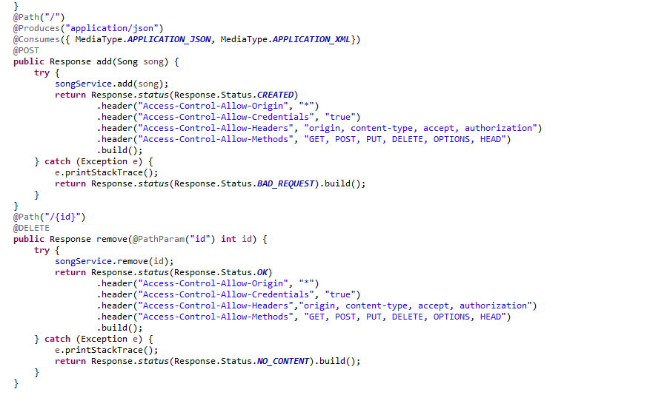
Big Exercise: Music Manager System
2.3. Project RESTFul:
Create a package and class in the package, we have:
Response add use add() method of SongService
Response remove use remove() method of SongService

Slide 34
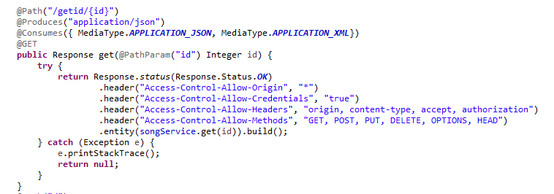
Big Exercise: Music Manager System
2.3. Project RESTFul:
The same, we have response update, get, getbyName, deleteAll, getCountListSong, getPaginationListSong uses update, get, getbyName, deleteAll, getCountListSong, getPaginationListSong method of SongService

Slide 35
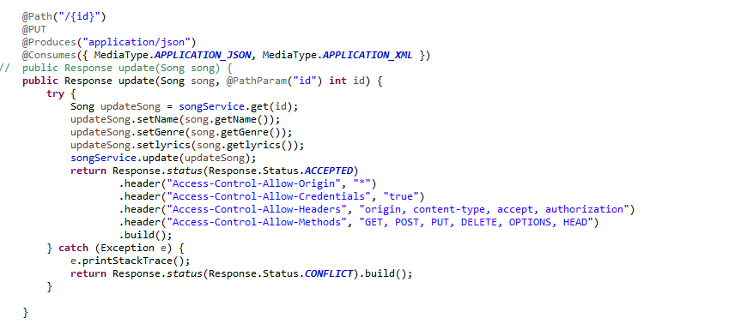
Big Exercise: Music Manager System
2.3. Project RESTFul:

Slide 36
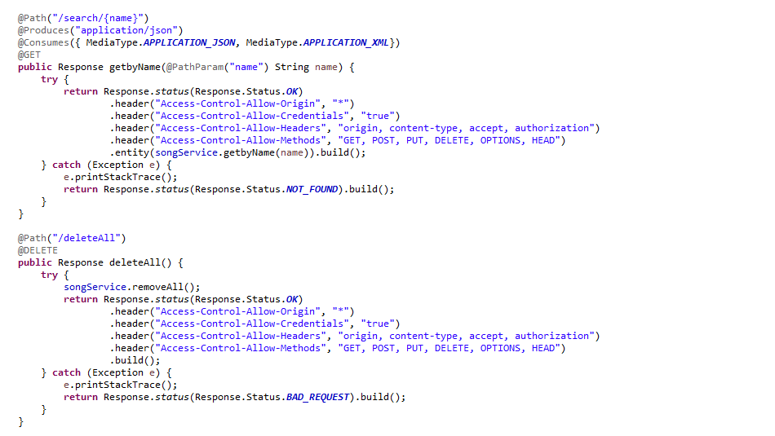
Big Exercise: Music Manager System
2.3. Project RESTFul:

Slide 37
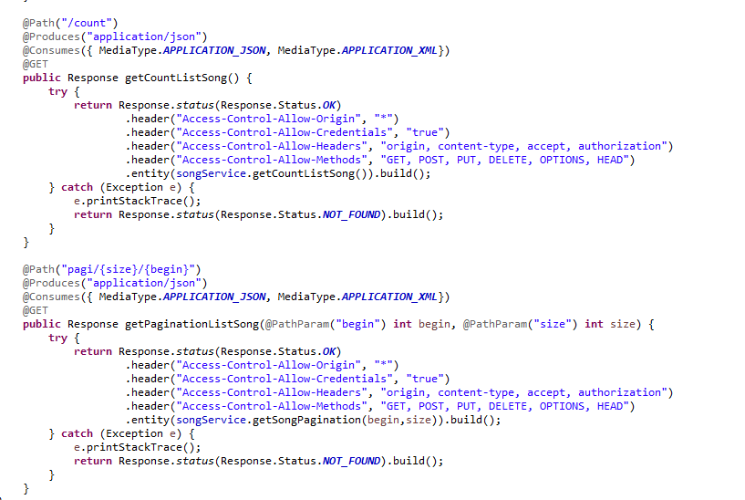
Big Exercise: Music Manager System
2.3. Project RESTFul:

Slide 38
Big Exercise: Music Manager System
2.4. Project Feature:
Base on Karaf feature RESTFul project, we define a same project with feature file about:
Define Datasource: create Database and use Datasource Name we define in Project Service
Define feature API: use Hibernate and deploy bundle form Project API
Define feature Service: Deploys feature API and project Service
Define feature RESTFul: Use feature API and Service and dependency bundle jackson

Slide 39
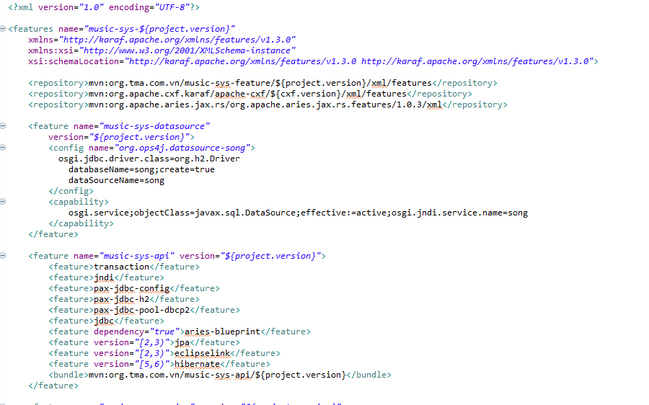
Big Exercise: Music Manager System
2.4. Project Feature:

Slide 40
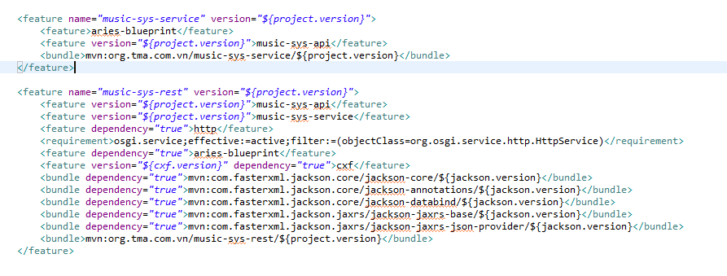
Big Exercise: Music Manager System
2.4. Project Feature:

Slide 41
Big Exercise: Music Manager System
2.5. Check API:
We install Project we build. But first, we need install feature cxf to feature rest working, because rest use jackson, jackson is a part cxf.
After install in karaf, we check API in PostMan.

Slide 42
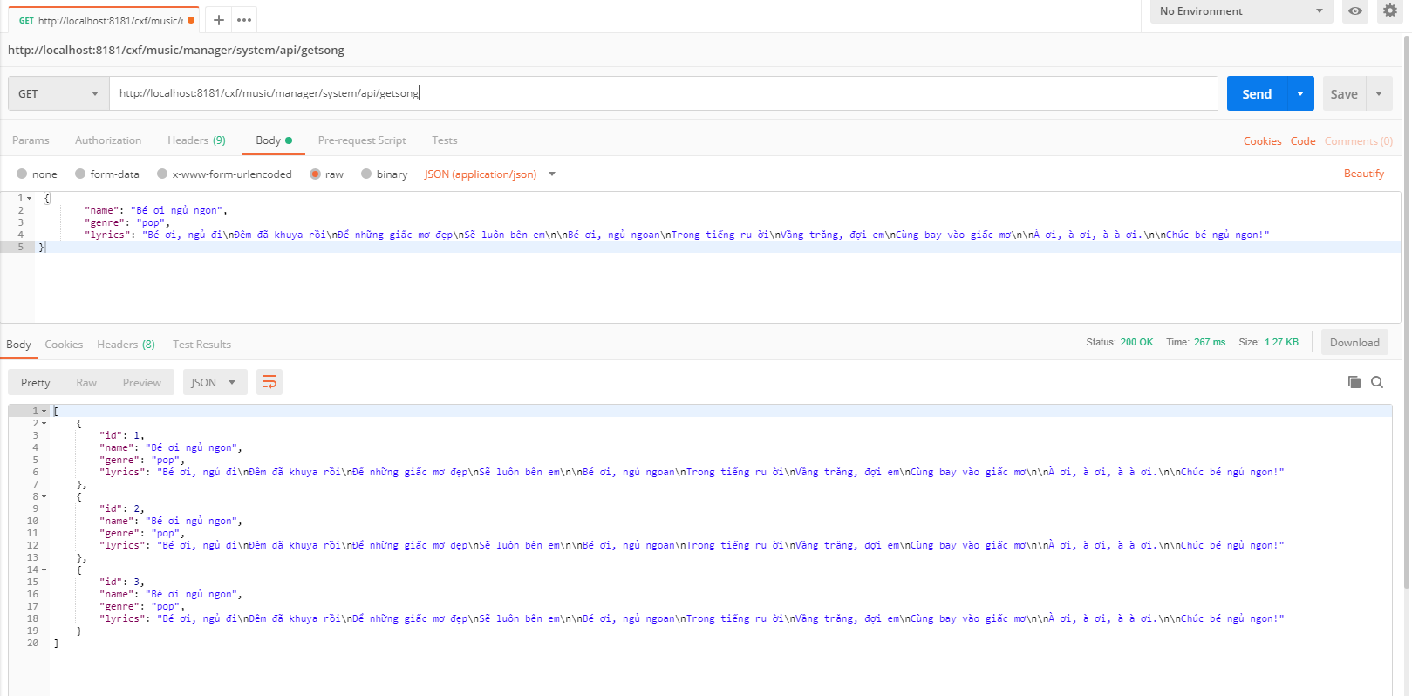
Big Exercise: Music Manager System
2.5. Check API:
Example, we check get list method after we have data

Slide 43
Big Exercise: Music Manager System
3. Client-Side:

